Slide 1
Cell construction scheme for various cubic fault tolerant Hamiltonian graphs
Hsu, Lih-Hsing

Slide 2
Thanks

Slide 4
So, I have time to do this research.

Slide 5
Cubic Hamiltonian connected graphs

Slide 6
Due to the time limit, I want to share with you my idea of finding the problem.

Slide 7
The road map for the shopping center nearby to Adam’s house is shown in Figure 3-15. One day, Adam and his father want to go home after going to a movie. On their way home, they decide to try all the delicious types of food nearby. However, to save energy, they only want to visit each store once. Can you help Adam and his father find a route allowing them to enjoy all the food before going home?
Figure 3-17

Slide 8
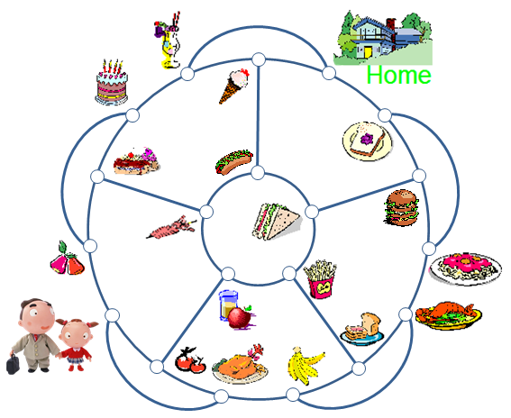
A solution is given in Figure 3-16.
Figure 3-18

Slide 9
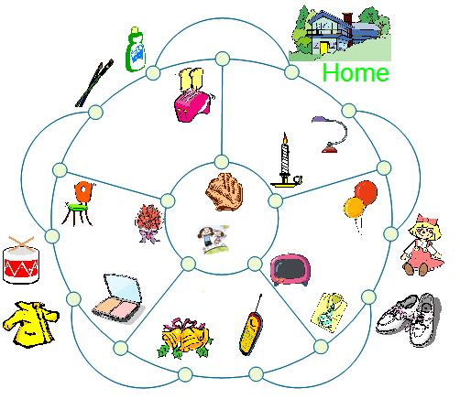
The next day, Adam’s sister, Vicky, and their mother intend to go home after church as illustrated in Figure 3-17. On the way home, they intend to go window shopping at all stores nearby. Again, they only want to visit each store once. Can you help Vicky and her mother find a route to shop at all the stores before going home?
Figure 3-19

Slide 10
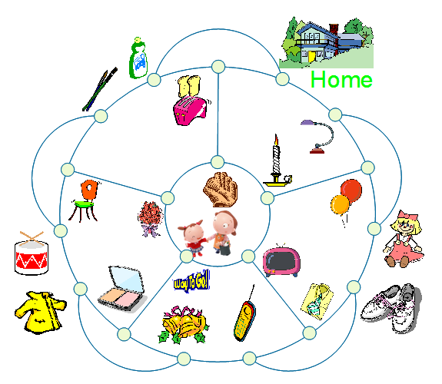
A solution is given in Figure 3-18
Figure 3-20

Slide 11
Figure 3-30
Figure 3-31

Slide 12
Figure 3-32
Figure 3-33

Slide 13
Figure 3-34
Figure 3-35

Slide 14
Figure 3-36
Figure 3-37

Slide 15
Figure 3-38
Figure 3-39

Slide 16
Figure 3-40

Slide 17
Figure 3-41

Slide 18
Figure 3-42
Figure 3-43

Slide 19
Figure 3-44

Slide 20
Figure 3-45

Slide 21
Figure 3-46

Slide 22
Figure 3-47

Slide 23
Figure 3-48

Slide 24
Figure 3-49

Slide 25
Figure 3-50

Slide 26
Figure 3-51
Figure 3-52

Slide 27
Figure 3-53

Slide 28
Figure 3-54

Slide 29
Cubic Hamiltonian laceable graphs

Slide 30
Figure 3-55
Figure 3-56

Slide 31
Figure 3-57

Slide 32
Figure 3-58
Figure 3-59

Slide 33
Figure 3-60

Slide 34
Figure 3-61

Slide 35
Figure 3-62

Slide 36
Figure 3-63

Slide 37
Figure 3-64

Slide 38
Figure 3-65

Slide 39
Figure 3-66

Slide 40
Figure 3-67

Slide 41
Figure 3-68

Slide 42
Cubic 1-edge fault tolerant Hamiltonian graphs

Slide 43
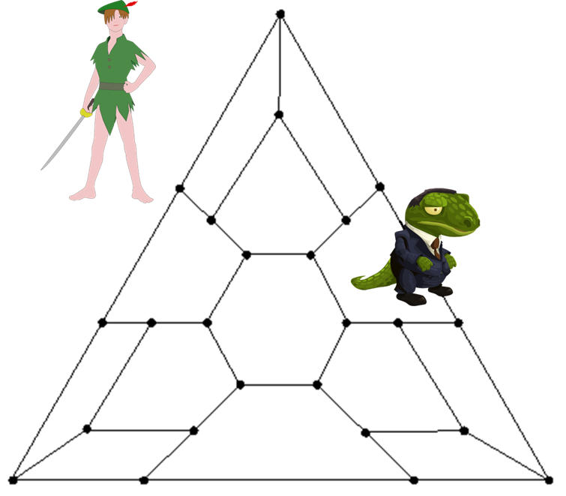
Peter Pan want to patrol the important cites of Neverland, as shown in Figure 4.1, and return his starting point. Yet, the crocodile is on an edge. Peter Pan must avoid the crocodile while patrolling. Can you design a tour for Peter Pan that visits all the cities and avoids the crocodile?
Figure 4-1

Slide 44
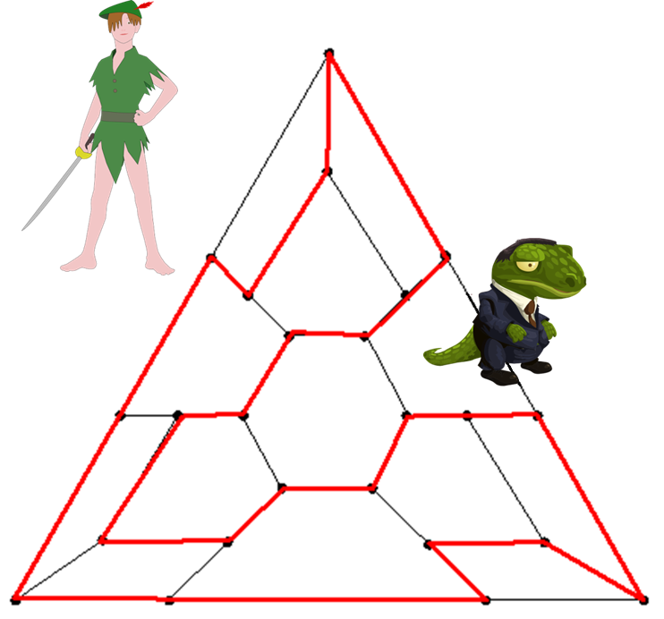
One possible solution is shown in Figure 4-2.
Of course, the crocodile may move to a different edge. Interestingly enough, Peter Pan will nonetheless always be able to avoid the crocodile while patrolling.
Figure 4-2

Slide 45
Cubic 1-vertex fault tolerant Hamiltonian graphs

Slide 46
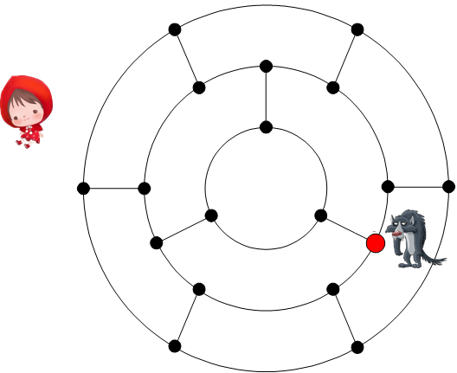
Now that we’ve considered faulty edges, how do we navigate graphs with a faulty vertex? Consider the following story:
The little red hat walks through the woods to deliver food to her sick grandmother. A wolf wants to eat the girl but is afraid to do so in public. Instead, the wolf hides at the colored vertex (Figure 4-6). Would you please help the little red hat by designing a tour that avoids the wolf?
Figure 4-6

Slide 47
A solution is given in Figure 4-7.
Figure 4-7

Slide 48
Cubic globlly 3*-connected graphs

Slide 49
To celebrate finding Cinderella, the happy prince intends to organize a parade from the palace to Cinderella’s home, visiting all the country’s cities in the process. For this reason, the Secretary of State arranged a Hamiltonian path as in Figure 5.1.
Figure 5-1

Slide 50
However, the prince was not satisfied with the solution because he wanted to see Cinderella as soon as possible. So, the Secretary of State worked very hard. Finally, he found a solution, shown in Figure 5-2. The parade was split into two groups, each group starting from the palace and ending at Cinderella’s home, but visiting all the country’s cities between the two groups.
Figure 5-2

Slide 51
Unfortunately, the prince was still unsatisfied with the solution. He criticized the plan for not using the third road from the palace. Can the second solution be improved by using all the roads from the palace? The Secretary of State tried again. Finally, he came up with the solution shown in Figure 5-3.
Figure 5-3

Slide 52
Construction Scheme
3-joins
Others

Slide 53
Figure 4-14

Slide 54
Figure 4-15
Figure 4-16

Slide 55
Figure 4-17

Slide 56
Figure 4-18

Slide 57
Figure 4-19

Slide 58
Figure 4-20

Slide 59
Figure 4-21

Slide 60
Figure 4-22

Slide 61
Figure 4-23

Slide 62
We can consider the corresponding vertex fault in graph G. Since graph G is 1-vertex fault tolerant Hamiltonian, we can find a faulty-free Hamiltonian cycle as shown in Figure 4-24.
Notice that the edge joining x to x₂ is not included in the Hamiltonian cycle (red line).
Figure 4-24

Slide 63
We can consider faulty the edge joining y to y₂ in graph H. Since graph H is 1-edge fault tolerant Hamiltonian, we can find a fault-free Hamiltonian cycle of H with the faulty edge (y,y₂) as shown in Figure 4-20. Again, we obtain a solution of the puzzle (Figure 4-14) shown below (Figure 4-25).
Figure 4-25

Slide 64
Node expansion
Figure 4-26

Slide 65
Figure 4-27

Slide 66
Figure 4-32

Slide 67
Figure 4-34

Slide 68
Question: How about cubic bipartite graphs

Slide 69
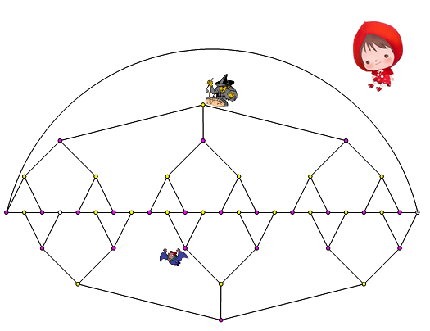
Figure 6-2

Slide 70
Cubic 1p-fault tolerant Hamiltonian graphs

Slide 71
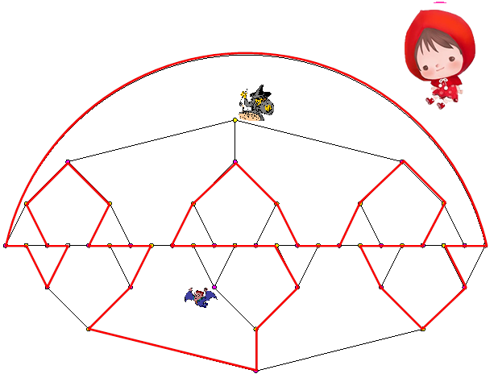
A solution is given in Figure 6-3.
Similar to previous examples, Little Red Hat can always find a solution no matter where the witch and Dracula are located, as long as one is at a red vertex and the other at a yellow vertex.
Figure 6-3

Slide 72
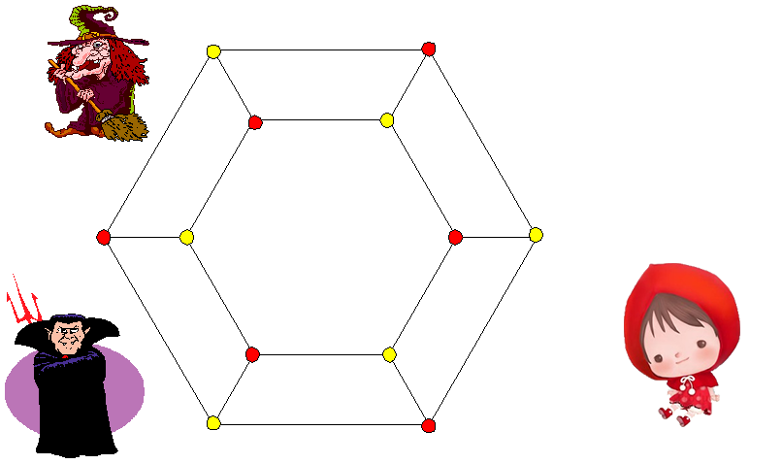
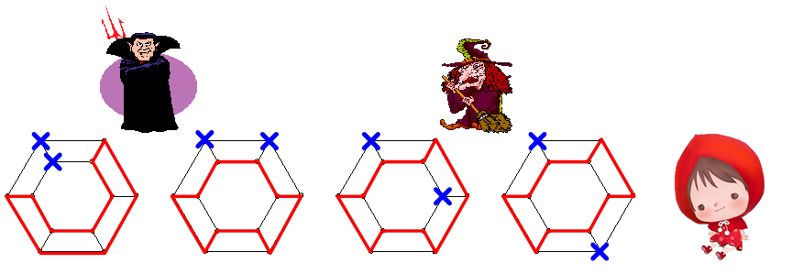
Again, let us use a much simpler graph to illustrate our problem (Figure 6-4).
Some solutions are shown in Figure 6-5.
Figure 6-4
Figure 6-5

Slide 73
Question: Construction Scheme for such cubic bipartite graphs.

Slide 74
Consider the graph in Figure 6-8 where one red vertex and one yellow vertex are faulty.
Figure 6-8

Slide 75
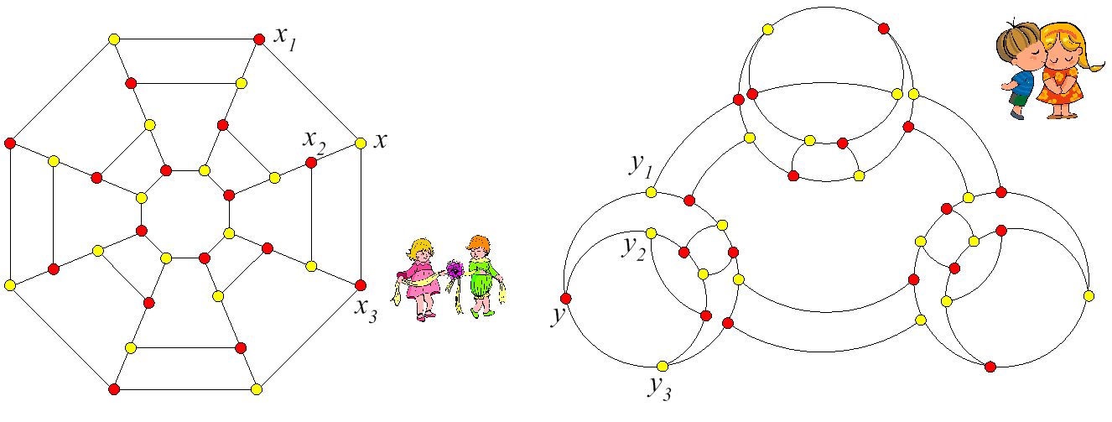
Note that the graph, labeled K, in Figure 6-8 is a 3-join of graph G, and graph H (from Figure 6-9) with vertex x with its neighbors x₁, x₂, and x₃ and vertex y with its neighbors y₁, y₂, and y₃.
Figure 6-9

Slide 76
Suppose the graph in Figure 6-8 is 1p-fault tolerant Hamiltonian. If so, the Hamiltonian cycle passes through two of the three edges used in a 3-join. This results in a Hamiltonian graph with one faulty red vertex (Figure 6-10).
Yet, we also mentioned at the beginning of this chapter that we cannot find a fault-free Hamiltonian cycle in Figure 6-10.
Figure 6-10

Slide 77
3-join does not work.
Before further discussion, we introduce other properties.

Slide 78
Cubic 1-edge fault tolerant Hamiltonian laceable graphs

Slide 79
Figure 6-11

Slide 80
One possible solution is shown in Figure 6-12.
Figure 6-12

Slide 81
Construction scheme?

Slide 82
Figure 6-15

Slide 83
Figure 6-16

Slide 84
Cubic Hyper Hamiltonian laceable graphs

Slide 85
Figure 6-19

Slide 86
Figure 6-20

Slide 87
Construction scheme

Slide 88
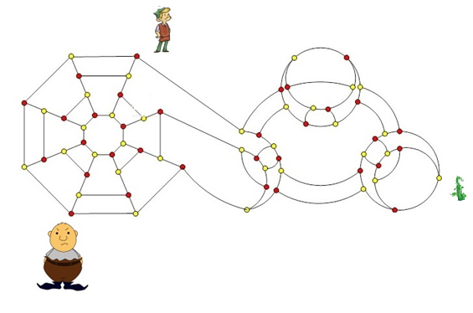
Figure 6-21

Slide 89
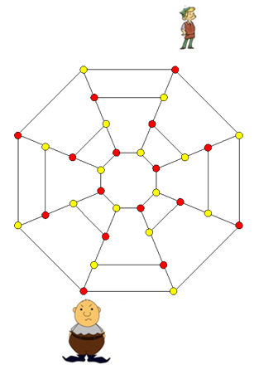
Figure 6-22

Slide 90
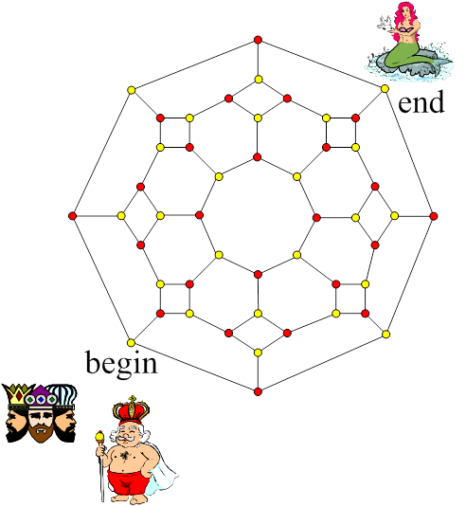
Globally 3*-laceable graphs
Find solution:
No solution.

Slide 91
Let us assume that there are three internal disjoint spanning paths, labeled P₁, P₂, and P₃, between the king’s vertex and the mermaid’s vertex. Suppose that there are a_{i} red vertices in P_{i} for i = 1,2,3. If so, there are a_{i} + 1 yellow vertices in Pi for i= 1,2,3. Hence, there are a₁ + a₂ + a₃ red vertices incident with the union of P₁, P₂, and P₃ and there are (a₁ + 1) + (a₂ + 1) +(a₃ + 1)-4 = a₁ + a₂ + a₃-1 yellow vertices incident with the union of P₁, P₂, and P₃. Then, the total number of vertices, both red and yellow, is an odd integer, which results in a contradiction. Thus, the puzzle unable to be solved.

Slide 92
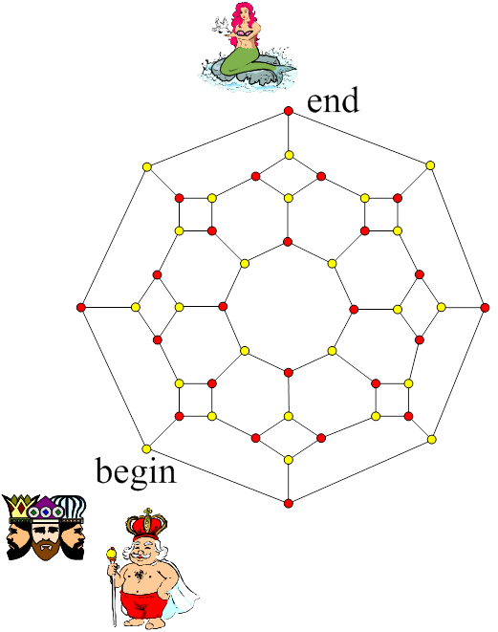
Figure 6-23

Slide 93
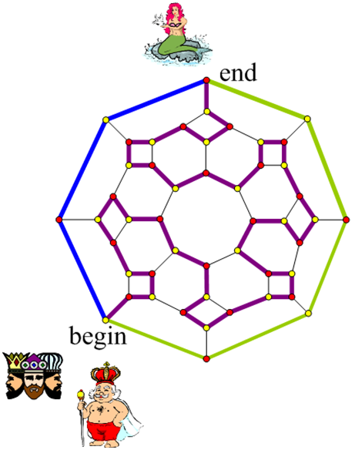
Figure 6-24

Slide 94
Find solution:
No solution.
Really?
Did you pray?
Figure 6-25

Slide 95
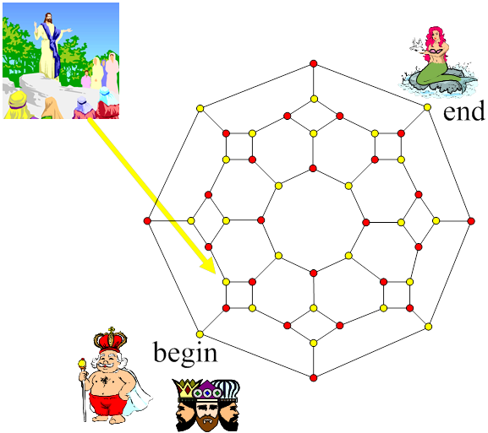
Figure 6-26

Slide 96
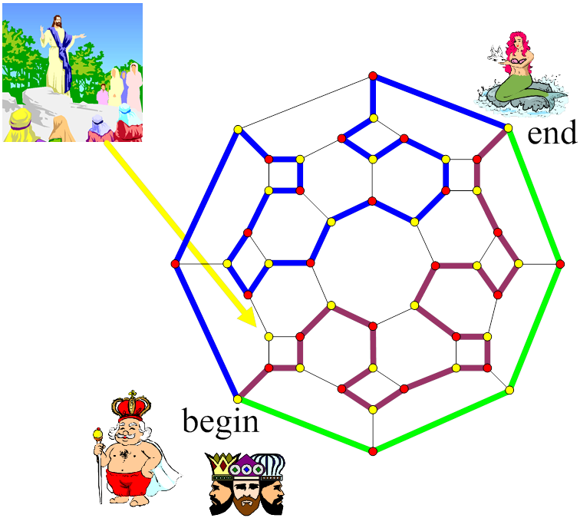
Figure 6-27

Slide 97
Construction scheme?

Slide 98
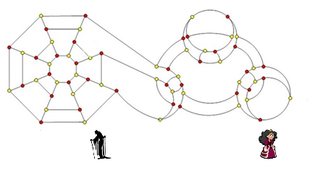
Figure 6-31

Slide 99
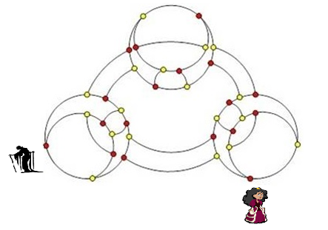
Figure 6-32

Slide 100
Construction schemes
3-join really does not work.
Did you pray?

Slide 101
Edge join
Yes, I pray very hard.
For the country? Still praying.
For the math problem. Some results.

Slide 102
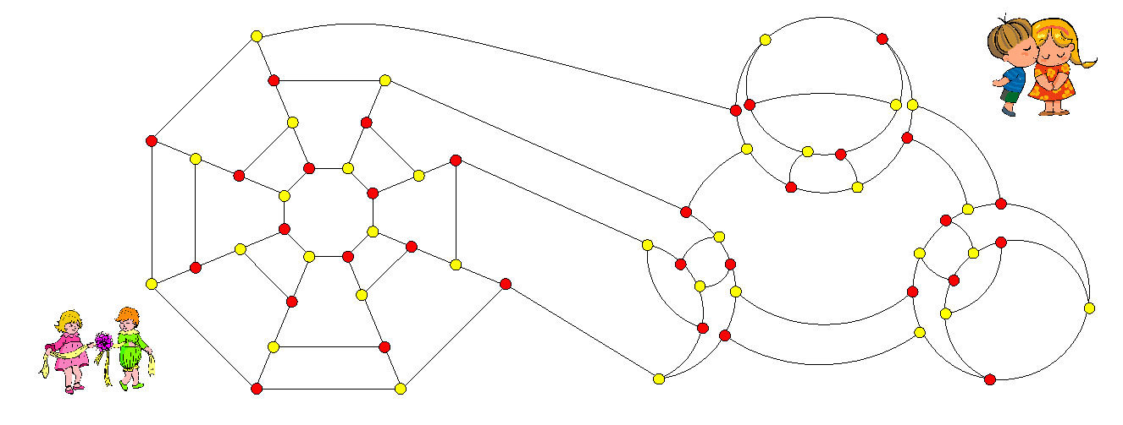
Figure 6-37

Slide 103
The edge join of two cubic graphs (or two cells) girth at least 4
P
A
A’
P’
P’
Q
Q’
R
R’
B
B’
S
S’

Slide 104
For the 1p-fault tolerant Hamiltonian graphs.

Slide 105
Let B be of a set of cubic bipartite graphs with the following properties:
1. Every path of length 3 can be extended into a Hamiltonian cycle.
2. Let (A,B) be any edge in G with Nbd(A)={P,Q,B}, Nbd(B)={A,R,S}, T is in Nbd(P)-{A,R,S} if such T exists. There are two possible partitions of {T,Q,R,S} into {{U,V},{W,X}} such that there exists two disjoint spanning paths Y and Z of G-{A,B,P} such that Y joins U to V and Z joins W to X.
3. If there exits a graph G in B containing a 4-cycle. Then K_{3,3} is in B. Moreover, the shrink of 4-cycle of G is in B if G is not K_{3,3}.
(Note: Property 3 can be viewed as the hereditary property for the set B with respect to property 1 and 2.)
Note that the vertex T does not exist when G is K_{3,3}.

Slide 106
2. Let (A,B) be any edge in G with Nbd(A)={P,Q,B}, Nbd(B)={A,R,S}, T is in Nbd(P)-{A,R,S} if such T exists. There are two possible partitions of {T,Q,R,S} into {{U,V},{W,X}} such that there exists two disjoint spanning paths Y and Z of G-{A,B,P} such that Y joins U to V and Z joins W to X.
P
T
T
P
T
A
P
A
A
Q
Q
Q
R
R
R
B
S
B
B
S
S

Slide 107
Theorem 1. Assume that B is a set of graphs with properties 1-3. Then all graphs in C(B) has Property 1-3.

Slide 108
Let C(B1p) be the set of graphs in C(B) with 1p-fault tolerant Hamiltonian.
Theorem 2. C(B1P) is closed under edge join.

Slide 109
Theorem 2. Let G and H be two cubic graphs of girth at least 4 with property 1-3 and 1-vertex fault tolerant Hamiltonian. Then the edge join of G and H is a cubic graph of girth at least 4 with property 1-3 and 1-vertex fault tolerant Hamiltonian.
Proof: Obviously, the edge join of G and H satisfies properties 1-3.
1-vertex fault tolerant.
Standard technique

Slide 110
Theorem 3. Let G be a cubic graph of girth at least 4 with properties 1-3 and 1-fault tolerant Hamiltonian and H be a cubic bipartite graph of girth at least 4 with property 1-3 and 1p-fault tolerant Hamiltonian. Then the edge join of G and H is a cubic graph of girth at least 4 with property 1-3 and 1-vertex fault tolerant Hamiltonian.
Proof: Obviously, the edge join of G and H satisfies properties 1-3.
1-vertex fault tolerant.
bipartite
non-bipartite

Slide 111
Now, we introduce another operation
Edge twist

Slide 112
We Add two new properties: Properties 4 and 5
4. For any two faulty independent edges e and f, either there exists a Hamiltonian cycle of G-{e,f} or there are two disjoint cycles spanning G-{e,f} such that the two vertices from any faulty edge incident with different cycle.
5. The deletion of any two adjacent vertices remains Hamiltonian.

Slide 113
How to get cubic graphs with Properties 4 and 5
Theorem 4. Assume G₁ and G₂ are any two cubic graphs with properties 4 and 5. Then any edge join of G₁ and G₂ is a cubic graph with properties 4 and 5.

Slide 114
Theorem 5. Assume G₁ and G₂ are any two cubic bipartite graphs with property 1-5. Then any edge twist of G₁ and G₂ is a cubic 1-fault tolerant Hamiltonian graph.
Edge twist

Slide 115
Property 6
P
P
A
A
Q
Q
R
M
R
M
B
B
N
N
Let (A,B) be any edge in G with Nbd(A)={P,Q,B}, Nbd(B)={A,R,S}, Nbd(R)={M,N,B}. There exists two Hamiltonian paths R₁ and R₂ of G-{A,B} joins P to Q such that R₁ can be written as P….,M,R,N,…,Q and R₂ can be written as P,…,N,R,N,…,Q.
Since girth is at at least 5, $\left\{M,N\right\}∩\left\{P,Q\right\}=∅.$

Slide 116
Girth at least 5
Let T(H) be the set of graphs generated from H with the operation ”edge twist”.
Theorem 3. T(H) is closed under edge twist if H satisfies property 1-6.
Example: P(18,4).

Slide 117
For other cubic bipartite variations
Time limit
We need more properties.
One argument: Too artificial.
My answer: It is important

Slide 118
Combine 3-join
Theorem: The 3-join of any two cubic Hamiltonian laceable graphs is a cubic Hamiltonian laceable graph.
Can we construct cubic Hamiltonian connected graphs?
We begin with some observation.
We have seen the edge twist of two cubic bipartite graph with certain properties will obtain a cubic Hamiltonian connected graphs.

Slide 119
This graph can be obtained from the edge twist of two K_{3,3}.
Thus, the graph is Hamiltonian connected.

Slide 120
We have another cubic Hamiltonian connected graph, say K₄. We can easily check that the 3-join of a sequence of K₄ remains Hamiltonian connected. This family is too trivial. Yet, K₄ may help us understand something behind.
In the following examples below, we may replace K₄ with any graph obtained from K₄ with a sequence of K₄.

Slide 121
This graph is obtained from the previous graph 3-join with K₄.
The graph is Hamiltonian connected.

Slide 122
Not Hamiltonian connected
Not Hamiltonian connected, again and again

Slide 123
This graph can be obtained from the edge twist of two Q₃.
Thus, the graph is Hamiltonian connected.
a
b
l
c
k
d
j
e
i
f
h
g

Slide 124
This graph is obtained from the previous graph 3-join with K₄.
The graph is Hamiltonian connected.

Slide 125
Hamiltonian connected
Hamiltonian connected
Repeated again and again
Why? I know

Slide 126
Question: extension to k-regular graphs

