Slide 1
Magic tricks, Group testing and de Bruijn sequences
Junyi David Guo @ 2019 Cross-strait
Joint work with Chao Yang and Hsiang-Chun Hsu

Slide 2
Group testing
Pooling design
Nonadaptive

Slide 3
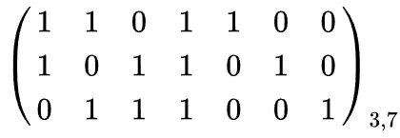
$\overline{1}$-seperable matrix
$1$-disjunct matrix

Slide 4
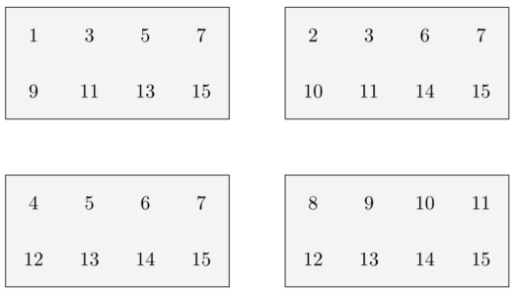
1 | 2 | 3 | 4 | 5 | 6 | 7 | 8 | 9 | 10 | 11 | 12 | 13 | 14 | 15
$$\left(\begin{matrix}1 & 0 & 1 & 0 & 1 & 0 & 1 & 0 & 1 & 0 & 1 & 0 & 1 & 0 & 1 \\ 0 & 1 & 1 & 0 & 0 & 1 & 1 & 0 & 0 & 1 & 1 & 0 & 0 & 1 & 1 \\ 0 & 0 & 0 & 1 & 1 & 1 & 1 & 0 & 0 & 0 & 0 & 1 & 1 & 1 & 1 \\ 0 & 0 & 0 & 0 & 0 & 0 & 0 & 1 & 1 & 1 & 1 & 1 & 1 & 1 & 1\end{matrix}\right)$$

Slide 6
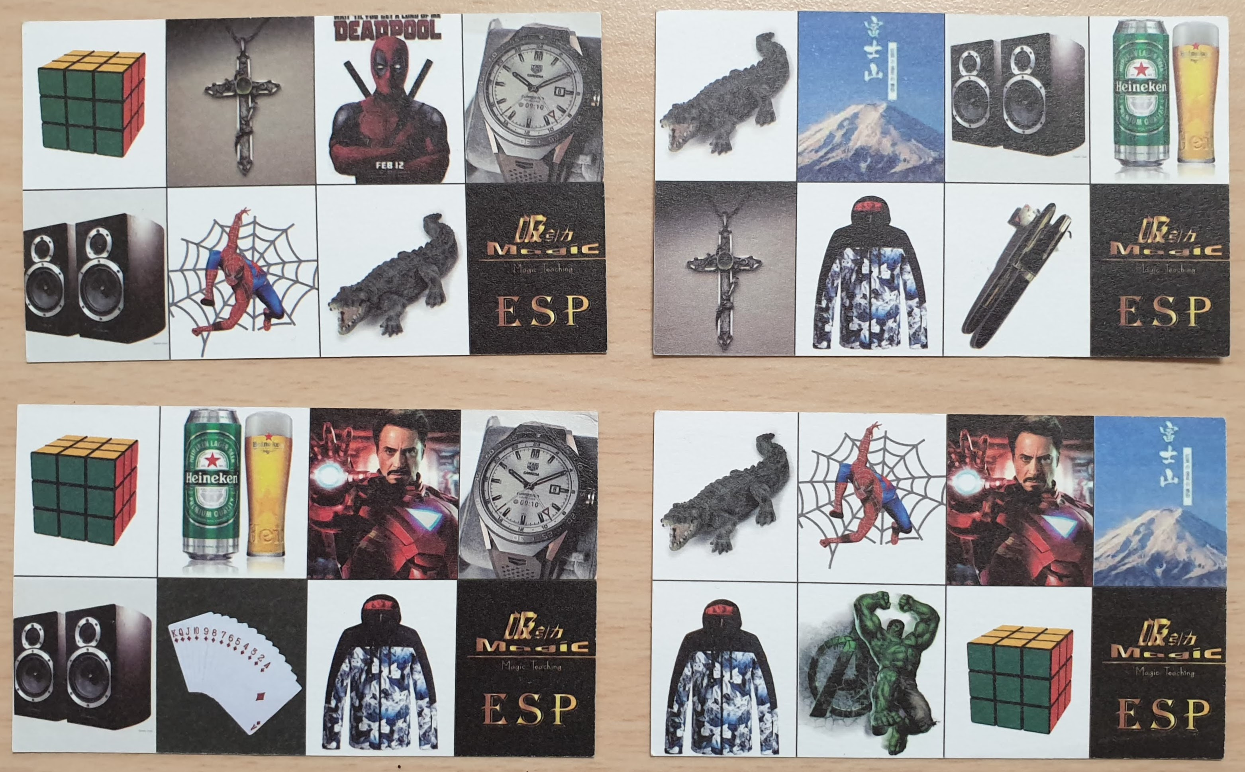

Slide 7
Question 1:
How about $1$ to any positive number $n$.

Slide 8
1 | 2 | 3 | 4 | 5 | 6 | 7 | 8 | 9 | 10 | 11 | 12 | 13 | 14 | 15
$$\left(\begin{matrix}1 & 0 & 1 & 0 & 1 & 0 & 1 & 0 & 1 & 0 & 1 & 0 & 1 & 0 & 1 \\ 0 & 1 & 1 & 0 & 0 & 1 & 1 & 0 & 0 & 1 & 1 & 0 & 0 & 1 & 1 \\ 0 & 0 & 0 & 1 & 1 & 1 & 1 & 0 & 0 & 0 & 0 & 1 & 1 & 1 & 1 \\ 0 & 0 & 0 & 0 & 0 & 0 & 0 & 1 & 1 & 1 & 1 & 1 & 1 & 1 & 1\end{matrix}\right)$$

Slide 9
1 | 2 | 3 | 4 | 5 | 6 | 7 | 8 | 9 | 10 | 11 | 12 | 13 | 14 | 15
$$\left(\begin{matrix}1 & 0 & 1 & 0 & 1 & 0 & 1 & 0 & 1 & 0 & 1 & 0 & 1 & 0 & 1 \\ 0 & 1 & 1 & 0 & 0 & 1 & 1 & 0 & 0 & 1 & 1 & 0 & 0 & 1 & 1 \\ 0 & 0 & 0 & 1 & 1 & 1 & 1 & 0 & 0 & 0 & 0 & 1 & 1 & 1 & 1 \\ 0 & 0 & 0 & 0 & 0 & 0 & 0 & 1 & 1 & 1 & 1 & 1 & 1 & 1 & 1\end{matrix}\right)$$

Slide 10
1 | 2 | 3 | 4 | 5 | 6 | 7 | 8 | 9 | 10 | 11 | 12 | 13 | 14 | 15
$$\left(\begin{matrix}1 & 0 & 1 & 0 & 1 & 0 & 1 & 0 & 1 & 0 & 1 & 0 & 1 & 0 & 1 \\ 0 & 1 & 1 & 0 & 0 & 1 & 1 & 0 & 0 & 1 & 1 & 0 & 0 & 1 & 1 \\ 0 & 0 & 0 & 1 & 1 & 1 & 1 & 0 & 0 & 0 & 0 & 1 & 1 & 1 & 1 \\ 0 & 0 & 0 & 0 & 0 & 0 & 0 & 1 & 1 & 1 & 1 & 1 & 1 & 1 & 1\end{matrix}\right)$$

Slide 11
1 | 2 | 3 | 4 | 5 | 6 | 7 | 8 | 9 | 10 | 11 | 12 | 13 | 14 | 15
$$\left(\begin{matrix}1 & 0 & 1 & 0 & 1 & 0 & 1 & 0 & 1 & 0 & 1 & 0 & 1 & 0 & 1 \\ 0 & 1 & 1 & 0 & 0 & 1 & 1 & 0 & 0 & 1 & 1 & 0 & 0 & 1 & 1 \\ 0 & 0 & 0 & 1 & 1 & 1 & 1 & 0 & 0 & 0 & 0 & 1 & 1 & 1 & 1 \\ 0 & 0 & 0 & 0 & 0 & 0 & 0 & 1 & 1 & 1 & 1 & 1 & 1 & 1 & 1\end{matrix}\right)$$

Slide 12
1 | 2 | 3 | 4 | 5 | 6 | 7 | 8 | 9 | 10 | 11 | 12 | 13 | 14 | 15
$$\left(\begin{matrix}1 & 0 & 1 & 0 & 1 & 0 & 1 & 0 & 1 & 0 & 1 & 0 & 1 & 0 & 1 \\ 0 & 1 & 1 & 0 & 0 & 1 & 1 & 0 & 0 & 1 & 1 & 0 & 0 & 1 & 1 \\ 0 & 0 & 0 & 1 & 1 & 1 & 1 & 0 & 0 & 0 & 0 & 1 & 1 & 1 & 1 \\ 0 & 0 & 0 & 0 & 0 & 0 & 0 & 1 & 1 & 1 & 1 & 1 & 1 & 1 & 1\end{matrix}\right)$$

Slide 13
Theorem 1
There exists constant weight $\overline{1}$-seperable $t×n$ matrix for any $n$.

Slide 17
Question 2:
Is it possible to reduce the number of question cards?
Yes!
$t=O\left(\log{n}\right)$
$O\left(1\right)$
$1$

Slide 18
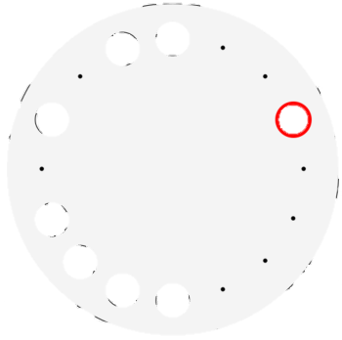

Slide 19
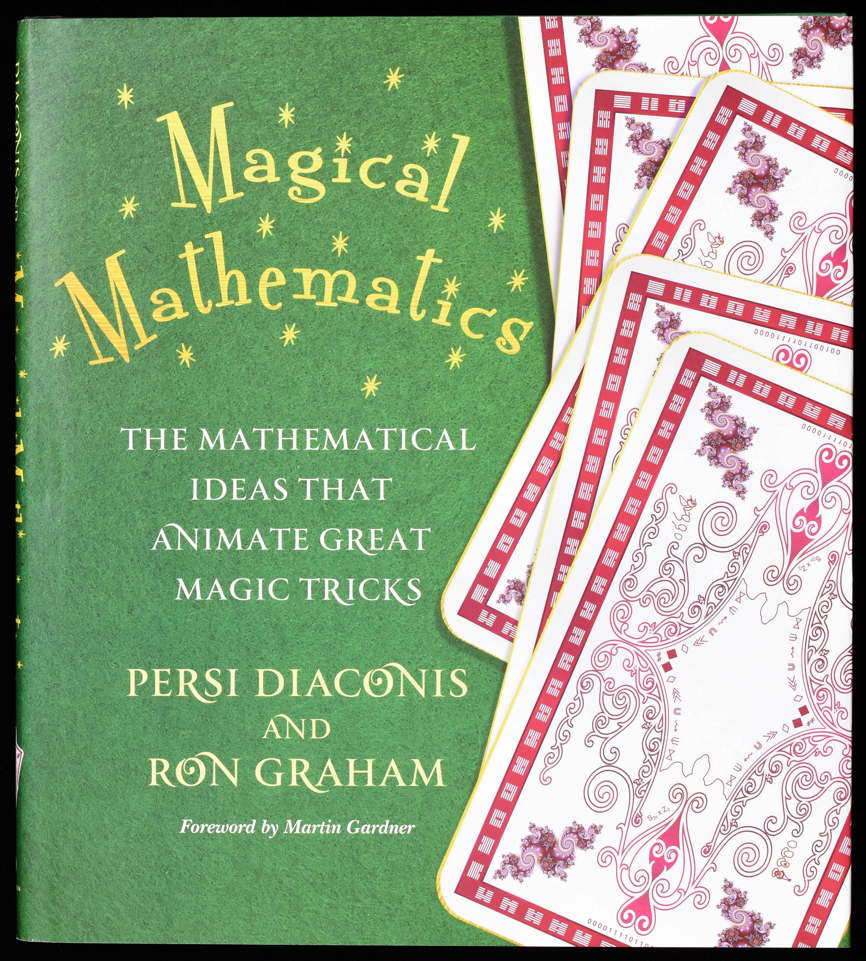

Slide 20
Notes:
https://halfrost.com/go_s2_de_bruijn/

Slide 21
De Bruijn Sequences
Universal Cycles
0000111101100101
00001001011001111100011011101010

Slide 22
Chang, Z., Ezerman, M.F., & Fahreza, A.A. (2019). On Greedy Algorithms for Binary de Bruijn Sequences. ArXiv, abs/1902.08744.
Dragon, P.B., Hernandez, O.I., Sawada, J., Williams, A., & Wong, D. (2018). Constructing de Bruijn sequences with co-lexicographic order: The k-ary Grandmama sequence. Eur. J. Comb., 72, 1-11.
Sawada, J., Williams, A., & Wong, D. (2016). Generalizing the Classic Greedy and Necklace Constructions of de Bruijn Sequences and Universal Cycles. Electr. J. Comb., 23, P1.24.

Slide 23
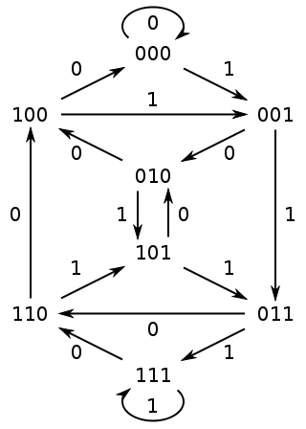
There are $2^{2^{k−1}−k}$ Eularian cycles.

Slide 24
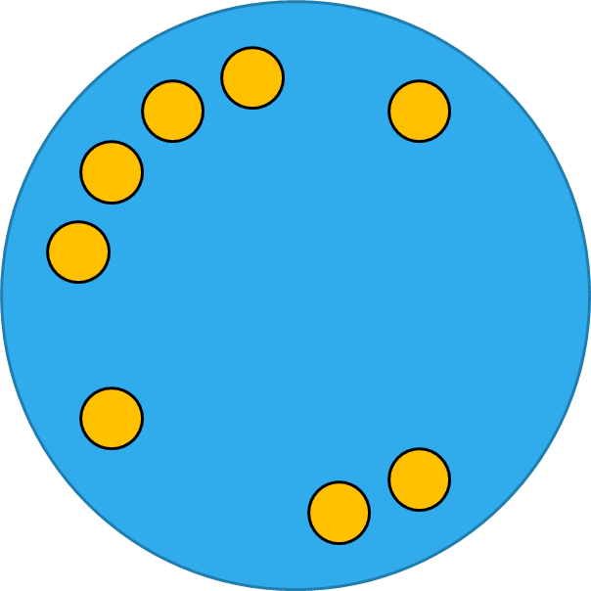
0000101111010011
5
2
11
1
7
0
15
8
14
12
13
6
10
3
4
9

Slide 25
備用
5
2
11
1
7
0
15
8
14
12
13
6
10
3
4
9

Slide 26
Theorem 2
There exists cyclic $1$-seperable $t×n$ matrix for $n=2^{k}$.
$$\left[\begin{matrix}0000101111010011 \\ 1000010111101001 \\ 1100001011110100 \\ 0110000101111010\end{matrix}\right]$$

Slide 27
Question
For and positive integer $n$ ?

Slide 28
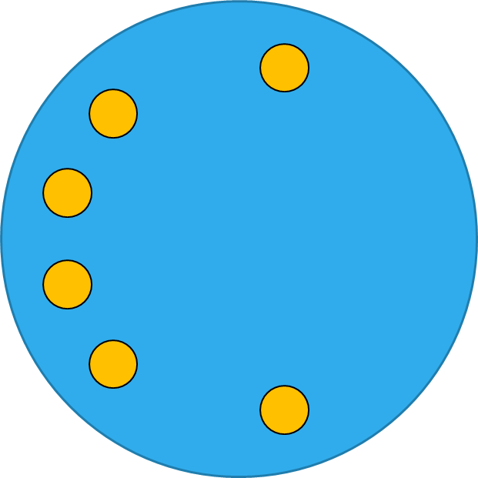
For example: $n=12$
Remove 0011001
=000010111101
2
1
5
0
11
8
7
4
15
10
14
13

Slide 29
備用
2
1
5
0
11
8
7
4
15
10
14
13

Slide 30
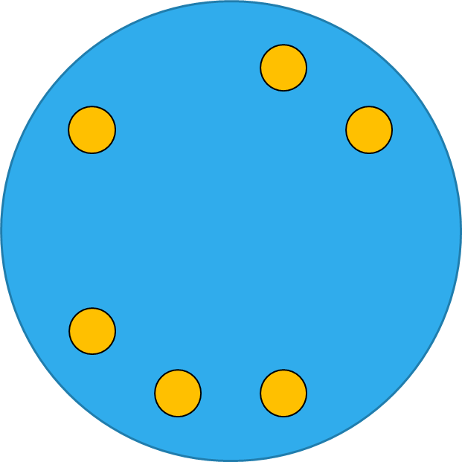
For example: $n=10$
Remove 0001000, 0000, 1111
=0011010111
6
3
13
9
10
12
5
14
11
7

Slide 31
備用
6
3
13
9
10
12
5
14
11
7

Slide 32
For example: $n=9$
1
2
8
4
12
9
14
3
7

Slide 33
備用

Slide 34
No Eularian cycle(disconnected)

Slide 35
$1$-error correcting version
R. Ehrenborg, Decoding the hamming code, Math Horizons, 13 (4) (2006) 17–18.
Todd D. Mateer, A magic trick based on the hamming code, Math Horizons 21, (2) 235 (2013) 9–11.

Slide 36
Hamming Code

Slide 37
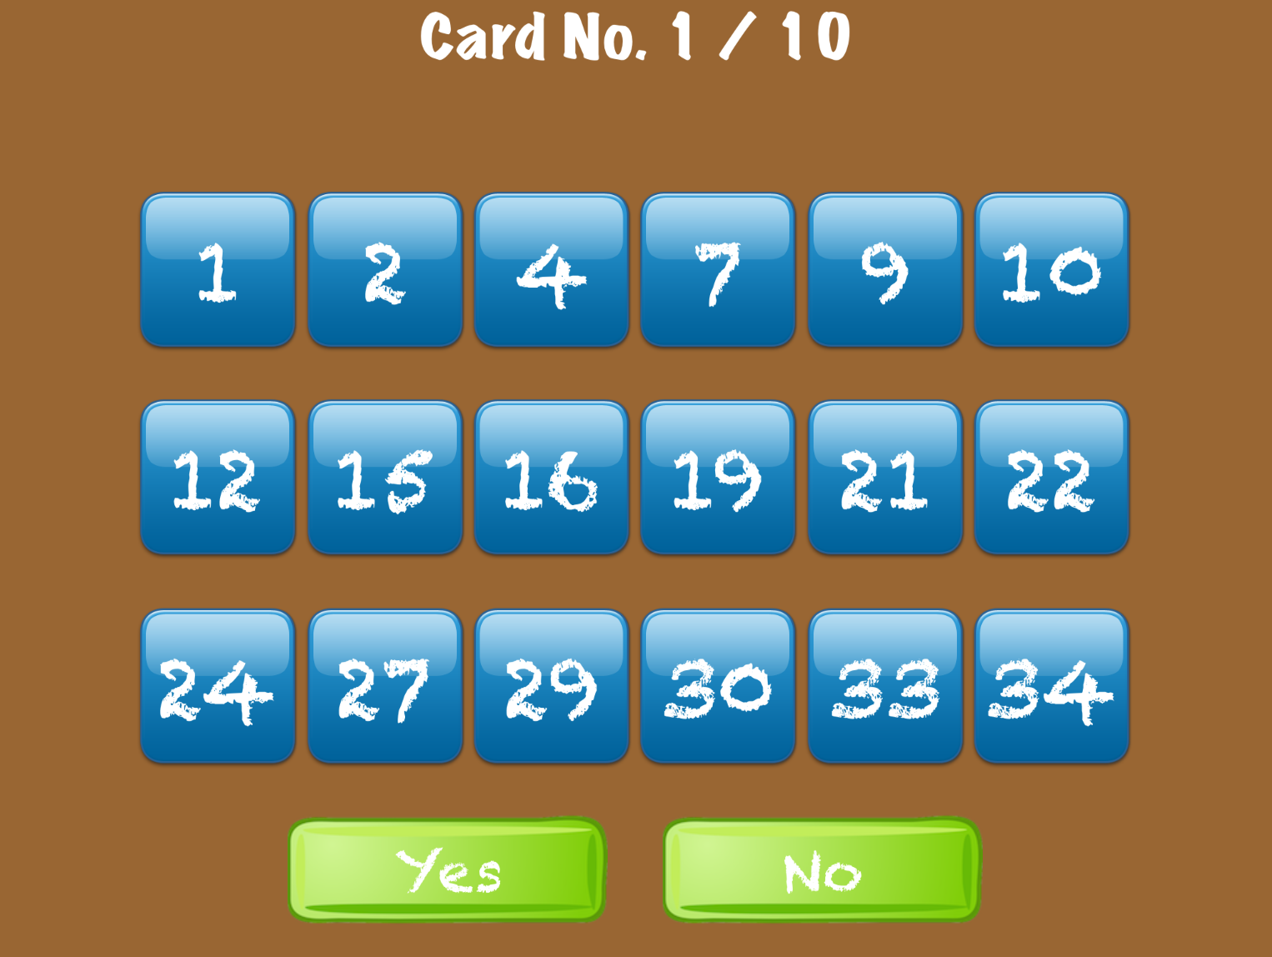
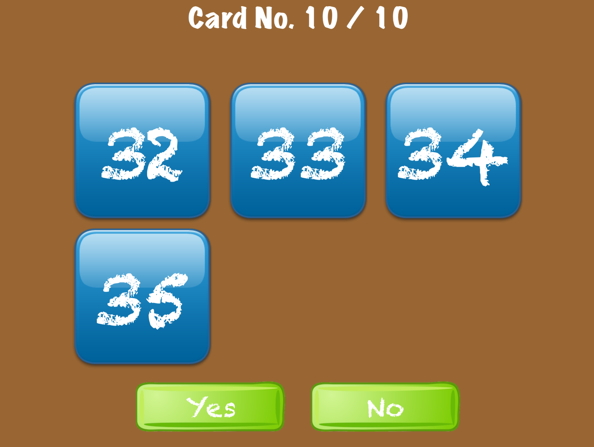

Slide 38
Theorem 1’
There exists $1$-error correcting constant weight $1$-seperable $t×n$ matrix for any $n$.

Slide 39
For example: $n=12$

Slide 40
Question
How about $1$-error correcting and cyclic?

Slide 41
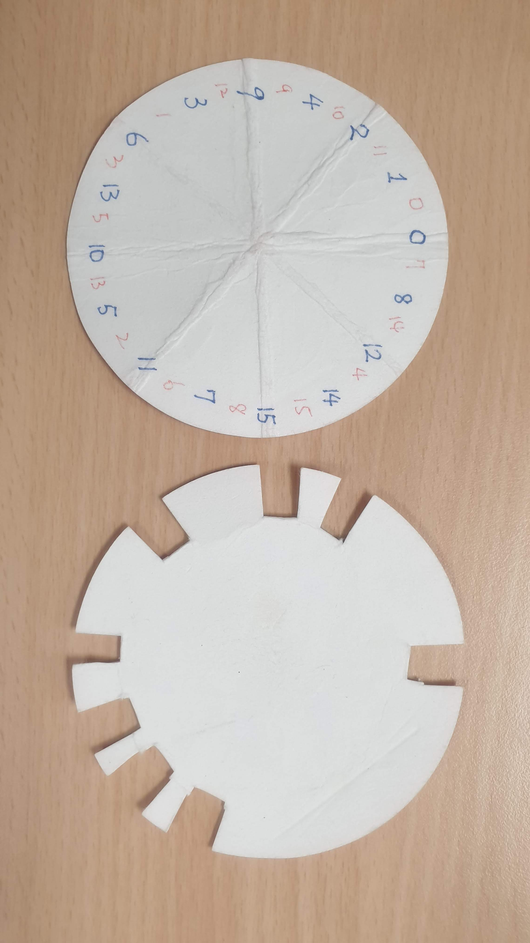

Slide 42
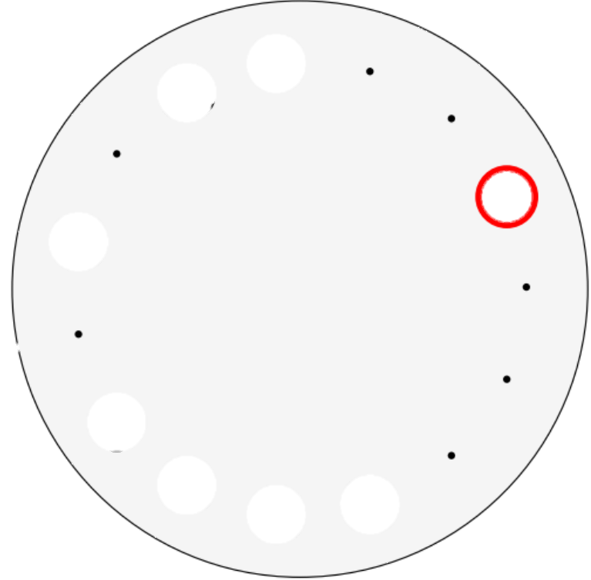

Slide 43
Theorem 3
There exists $1$-error correcting cyclic $1$-seperable $t×n$ matrix for $n=2^{k}−1$.
One-question-card or single-device design.

Slide 44
Proof.
Find the primitive polynomial $h(x)$ of degree $k$.
Let $g\left(x\right)=\frac{x^{2^{k}−1}−1}{h\left(x\right)}≡\sum{a_{i}x^{i}}$.
$a_{0}a_{1}⋯a_{2^{k}−1}$ is a de Bruijn sequence.

Slide 45
For example $n=31$
Let $h\left(x\right)=1+x^{2}+x^{3}+x^{4}+x^{5}$.
Then
1011010100011101111100100110000
1,2,5,11,22,13,26,21,10,20,8,17,3,7,14,29,27,23,15,31,30,28,25,18,4,9,19,6,12,24,16

Slide 47
Question
For and positive integer $n$ ?

Slide 48
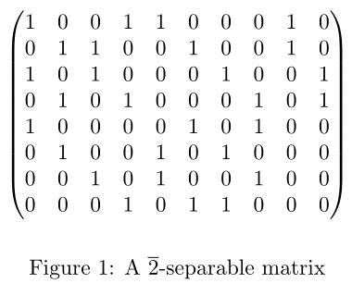
Question
$2$-error-correcting?

Slide 49
Question
One-question-card Reed-Solomon Code Magic Trick?
Todd D. Mateer, A Reed-Solomon Code Magic Trick. Mathematics Magazine, 87(2), (2014), 125-131.

Slide 50
Thanks!

