Slide 1
Transferable domination
number of graphs

Slide 2
Dominating set
Domination number
Example.
Dominating set:

Slide 3
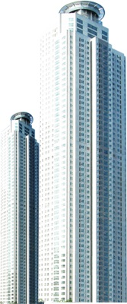
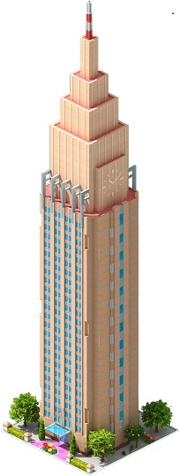
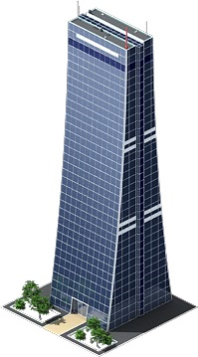
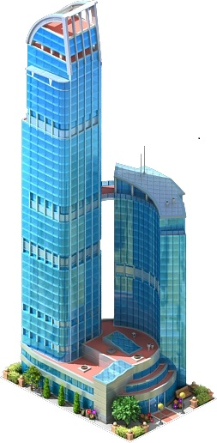

˙
˙
cell site
A
B

Slide 4
We want to move a mobile server(from A to B),
Is it possible?
and we need to guarantee that any one can receive
If so, how to place the mobile server?
the same service at any time.
˙
˙
A
B

Slide 5


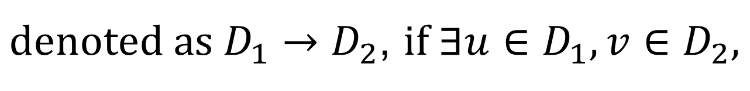

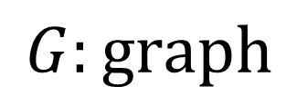
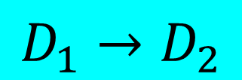



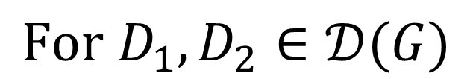


(Fujita)
Transferable-domination problem
$$G:graph$$
$$𝒟(G)=\{D:D is a dominating set of G\}$$
$$For D_{1}, D_{2}∈𝒟(G)$$
$$D_{1} is single\text{−}step transferable to D_{2},$$
$denoted as D_{1}→D_{2}$, if $∃u∈D_{1},v∈D_{2},$
$$uv∈E\left(G\right), such that{ D}_{1}−\left\{u\right\}=D_{2}−\left\{v\right\}$$
Example.
$$v$$
$$v$$
$$G$$
$$G$$
$$D_{1}→D_{2}$$
$$u$$
$$u$$
$$D_{1}$$
$$D_{2}$$

Slide 6
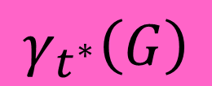
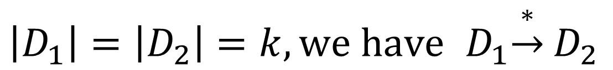
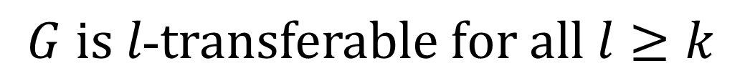

$$We write{ D}_{1}\underset{→}{∗}D_{2} if D_{1} can be transferred$$
$$to D_{2} through a sequence of single\text{−}step$$
$$transfers$$
$$We say that G is k\text{−}transferable if for any$$
$$two dominating sets D_{1},D_{2} of G with$$
$\left|D_{1}\right|=\left|D_{2}\right|=k, we have$ ${ D}_{1}\underset{→}{∗}D_{2}$
$$γ_{t^{∗}}\left(G\right)$$
$$The smallest integer k to guarantee that$$
$$G is l\text{−}transferable for all l≥k$$

Slide 7





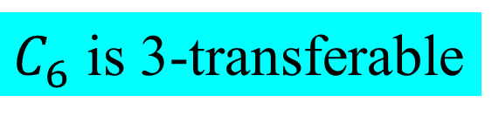







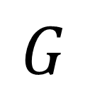


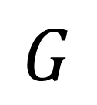









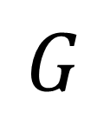



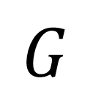

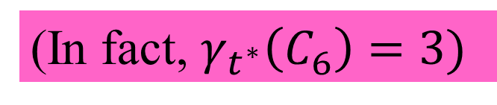

Example.
$C_{6}$ is 3-transferable
(In fact, $γ_{t^{∗}}\left(C_{6}\right)=3)$
$$v_{1}$$
$$v_{1}$$
$$v_{6}$$
$$v_{2}$$
$$v_{6}$$
$$v_{2}$$
$$G$$
$$G$$
$$v_{5}$$
$$v_{3}$$
$$v_{5}$$
$$v_{3}$$
$$v_{4}$$
$$v_{4}$$
Dominating set :
$$\{v_{1},v_{3},v_{5}\}$$
Dominating set :
$$\{v_{2},v_{3},v_{5}\}$$
$$v_{1}$$
$$v_{1}$$
$$v_{6}$$
$$v_{2}$$
$$v_{6}$$
$$v_{2}$$
$$G$$
$$G$$
$$v_{5}$$
$$v_{3}$$
$$v_{5}$$
$$v_{3}$$
$$v_{4}$$
$$v_{4}$$
Dominating set :
$$\{v_{2},v_{4},v_{5}\}$$
Dominating set :
$$\{v_{2},v_{4},v_{6}\}$$

Slide 8
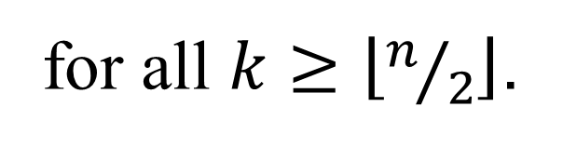

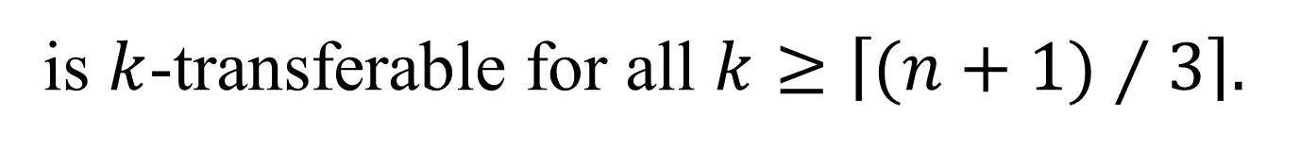
Theorem. (Fujita)
$\text{Any} \text{tree} T \text{with} n \text{vertices}$is $k$-transferable
for all $k≥\left\lfloor n/2\right\rfloor$.
Theorem. (Fujita)
$$\text{Every} \text{Hamiltonian} \text{graph} G \text{with} n \text{vertices}$$
is $k$-transferable for all $k≥\left\lceil (n+1)⁄3\right\rceil .$

Slide 9
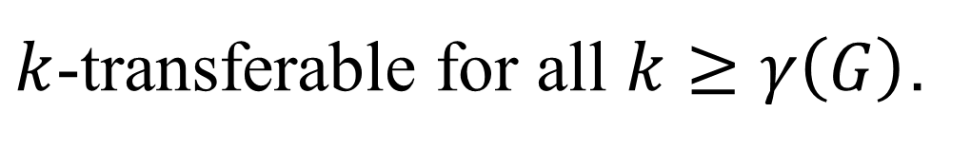
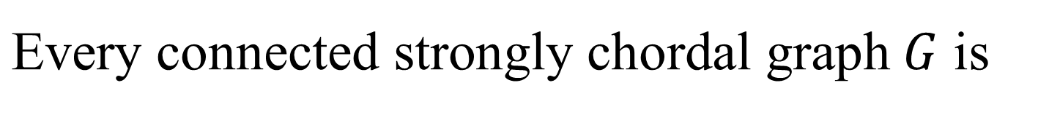
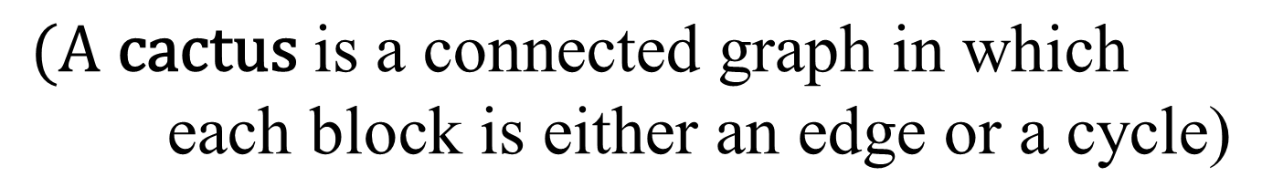
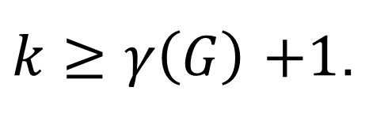
Theorem. (Chu et al.)
$\text{Every} \text{connected} \text{strongly} \text{chordal} \text{graph} G$ is
$k$-transferable for all $k≥γ\left(G\right)$.
Theorem. (Chu et al.)
$$\text{Every} \text{cactus} G \text{is} k\text{−}\text{transferable} \text{for} \text{all}$$
$k≥γ\left(G\right)$ $+1$.
$$\text{(}\text{A} \text{cactus} \text{is} \text{a} \text{connected} \text{graph} \text{in} \text{which} \text{each} \text{block} \text{is} \text{either} \text{an} \text{edge} \text{or} \text{a} \text{cycle}\text{)}$$

Slide 10
Definitions
and
propositions

Slide 11





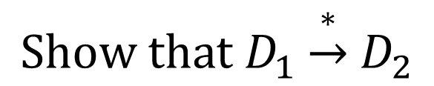
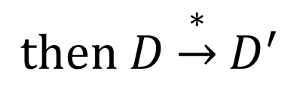
Question.
$$How to determine γ_{t^{∗}}\left(G\right)?$$
Idea.
$$To show that γ_{t^{∗}}\left(G\right)=k$$
Step 1.
$$Find dominating sets D_{1},D_{2},$$
$$\left|D_{1}\right|=\left|D_{2}\right|=k−1$$
$$Show that D_{1}\underset{→}{∗}D_{2}$$
$$γ_{t^{∗}}\left(G\right)≥k$$
Step 2.
$$Find a dominating set{ D}^{′}, \left|D^{′}\right|=l(l≥k)$$
(Standard form)
$$Show that if D is a dominating set, \left|D\right|=l,$$
$$then D\underset{→}{∗}D^{′}$$
$$γ_{t^{∗}}\left(G\right)≤k$$

Slide 12

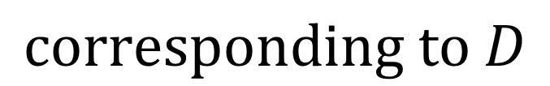




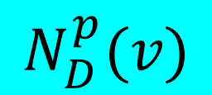


$$Let G be a graph, D⊆V\left(G\right), and v∈D.$$
$$u∈V\left(G\right)−D is called a private neighbor$$
$$of v corresponding to D if N\left(u\right)∩D=\{v\}$$
v is an unmovable vertex
$$v$$
$$w$$
$$G$$
$N_{D}^{p}(v)=\{$u,w}
$$D$$
$$u$$
private neighbor of v
$$N_{D}^{p}(v)$$
u is not dominated by any vertex
$$The set of all private neighbors of v$$
$$corresponding to D$$
$$For a dominating set D of G, a vertex v in D$$
$$is called unmovable if it has two$$
$$nonadjacent private neighbors$$

Slide 13
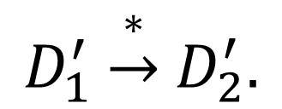
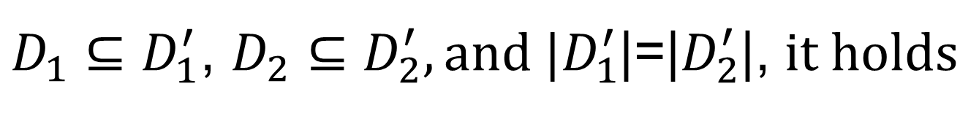
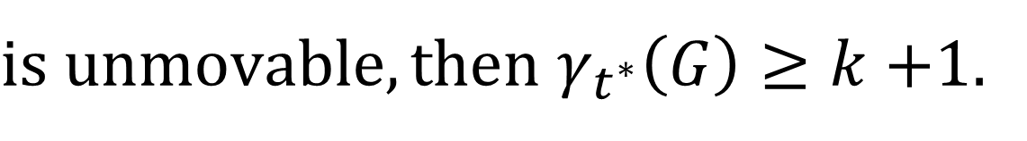
Proposition.
$$Let G be a graph, D_{1}, D_{2} be distict dominating$$
$sets of G, \left|D_{1}\right|=\left|D_{2}\right|=k. If each vertex in{ D}_{1}$
$is unmovable, then γ_{t^{∗}}\left(G\right)≥k+$1.
Lemma. (Fujita)
$$Let D_{1}, D_{2} be dominating set of G. If D_{1}=D_{2},$$
$${or D}_{1}\underset{→}{∗}D_{2}, then for any D_{1}^{′} and D_{2}^{′} such that$$
$D_{1}⊆D_{1}^{′}$, $D_{2}⊆D_{2}^{′}, and |D_{1}^{′}$|=|$D_{2}^{′}$|, $it holds$
$$D_{1}^{′}\underset{→}{∗}D_{2}^{′}.$$

Slide 14
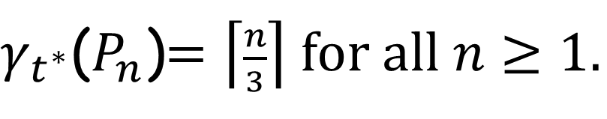
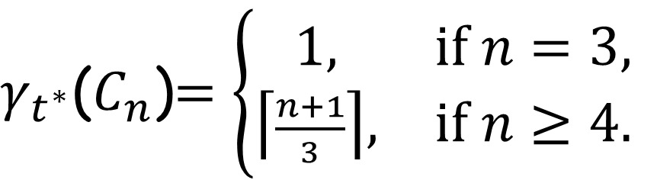

Proposition.
$$For any graph G, γ\left(G\right)≤γ_{t^{∗}}\left(G\right).$$
Theorem.
$γ_{t^{∗}}$($P_{n}$)$=\left\lceil \frac{n}{3}\right\rceil for all n≥1.$
Theorem.
$$For n≥3,$$
$γ_{t^{∗}}$($C_{n}$)$=\left\{\begin{matrix}1, & if n=3, \\ \left\lceil \frac{n+1}{3}\right\rceil , & if n≥4.\end{matrix}\right.$

Slide 15
Transferable domination
number of grids

Slide 16
Given two graphs and , the Cartesian
product of and , denoted ,
is defined by

Slide 17
Example.

Slide 18
$$For convenience, when consider the graph$$
$$P_{m}×P_{n}, we always assume that$$
$$V\left(P_{m}×P_{n}\right)=\{v_{ij}:0≤i≤m−1,0≤j≤n−1\}$$
$$E\left(P_{m}×P_{n}\right)=\{v_{ij}v_{kl}:\left|i−k\right|+\left|j−l\right|=1\}$$

Slide 19
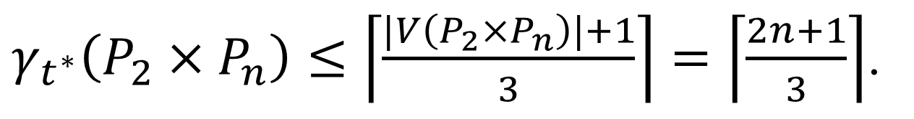
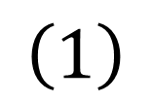
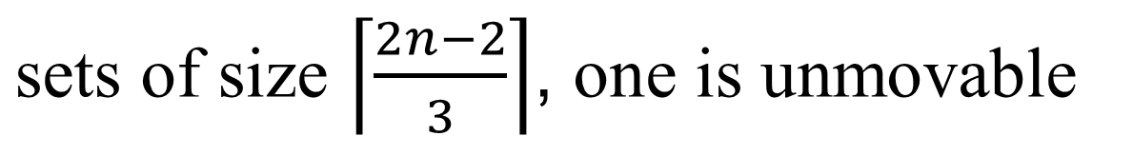
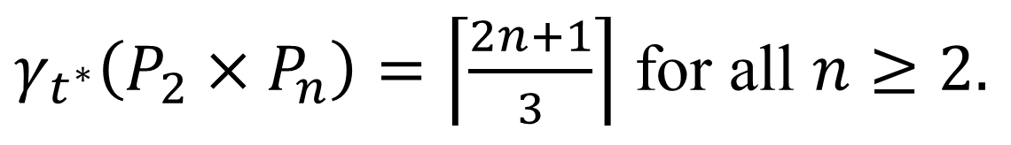

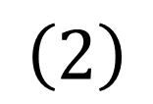
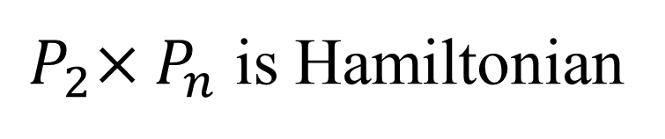
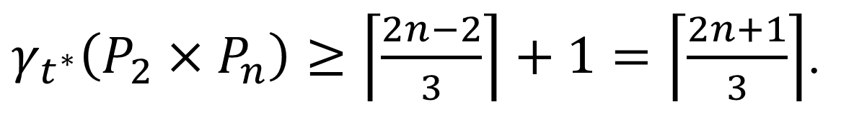
Theorem.
$γ_{t^{∗}}\left(P_{2}×P_{n}\right)=\left\lceil \frac{2n+1}{3}\right\rceil$ for all $n≥2.$
Proof.
$$\left(1\right)$$
${ P}_{2}×P_{n}$ is Hamiltonian
$γ_{t^{∗}}\left(P_{2}×P_{n}\right)≤\left\lceil \frac{|V\left(P_{2}×P_{n}\right)|+1}{3}\right\rceil =\left\lceil \frac{2n+1}{3}\right\rceil$.
$$\left(2\right)$$
For all $n≥5,\text{there} \text{exists} \text{two} \text{dominating}$
$\text{sets} \text{of} \text{size}$ $\left\lceil \frac{2n−2}{3}\right\rceil$, $\text{o}\text{ne} \text{is} \text{unmovable}$
$γ_{t^{∗}}\left(P_{2}×P_{n}\right)≥\left\lceil \frac{2n−2}{3}\right\rceil +1=\left\lceil \frac{2n+1}{3}\right\rceil$.

Slide 20

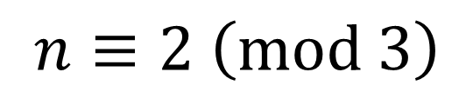
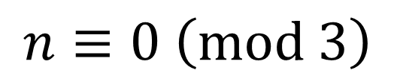

Case 1.
$$n≡2 \left(mod 3\right)$$
$$v$$
$$u$$
private neighbors of v
private neighbors of u
u is an unmovable vertex
v is an unmovable vertex
Case 2.
$$n≡0 \left(mod 3\right)$$

Slide 21
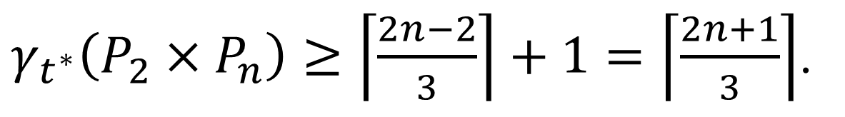
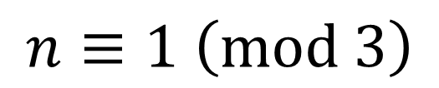
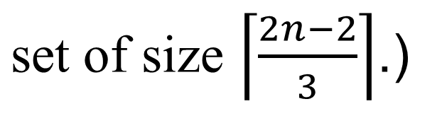
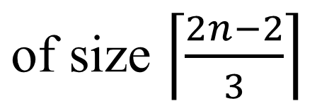
Case 3.
$$n≡1 \left(mod 3\right)$$
$$\text{there} \text{exists} \text{an} \text{unmovable} \text{dominating} \text{set}$$
$\text{of} \text{size}$ $\left\lceil \frac{2n−2}{3}\right\rceil$
$$\text{(}\text{we} \text{can} \text{easily} \text{construct} \text{another} \text{dominating}$$
$\text{set} \text{of} \text{size}$ $\left\lceil \frac{2n−2}{3}\right\rceil$.)
$γ_{t^{∗}}\left(P_{2}×P_{n}\right)≥\left\lceil \frac{2n−2}{3}\right\rceil +1=\left\lceil \frac{2n+1}{3}\right\rceil$.

Slide 22
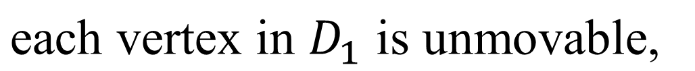
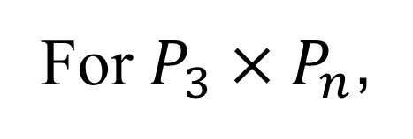






Lemma.
$γ_{t^{∗}}\left(P_{m}×P_{n}\right)>\frac{mn}{3}$ if$mn≡0 \left(mod 3\right).$
Idea.
For $P_{3}×P_{n}$,
both $D_{1}$
$$v$$
private neighbors of v
and $D_{2}$
$$γ_{t^{∗}}\left(P_{3}×P_{n}\right)>\left|D_{1}\right|=\frac{3n}{3}=n$$
$\text{are} \text{dominating} \text{set} \text{of} P_{3}×P_{n}$,
$\text{each} \text{vertex} \text{in} D_{1}$ $\text{i}\text{s} \text{unmovable}\text{,}$

Slide 23







Theorem.
$γ_{t^{∗}}\left(P_{3}×P_{n}\right)=n+1$ for all $n≥2.$
Proof.
$$\left(1\right)$$
By the lemma above,
$$γ_{t^{∗}}\left(P_{3}×P_{n}\right)≥\left\lceil \frac{3n}{3}\right\rceil +1=n+1.$$
$$\left(2\right)$$
We prove that by $γ_{t^{∗}}\left(P_{3}×P_{n}\right)≤n+1$
by induction on $n$
$$n=2$$
follows from the theorem above

Slide 24






$$n=3$$
Consider the dominating set
$D^{′}=\left\{v_{10},v_{11},v_{12},v_{00}\right\}$of $P_{3}×P_{n}$
$$P_{3}×P_{n}$$
We show that if $D$ is a dominating set of
$P_{3}×P_{n}$, $\left|D\right|=4, then$
$D\underset{→}{∗}$ $D^{′}$

Slide 25









Case 1.
$$\left\{v_{20},v_{01}\right\}⊆D$$
move $v_{20}$ to $v_{10}$, move $v_{22}$ to $v_{21}$, and move $v_{01}$ to $v_{00}$
$D\underset{→}{∗}$ $D^{′}$ in this case
one of the three vertices is in D
move this vertex to $v_{22}$
move the forth vertex to $v_{11}$
Case 2.
$$\left\{v_{20},v_{00}\right\}⊆D,$$
$$or \left\{v_{10},v_{00}\right\}⊆D$$
back to Case 1
move $v_{00}$ to $v_{10}$
move $v_{10}$ to $v_{20}$
move $v_{00}$ to $v_{01}$
only need to consider the case that $|D∩\left\{v_{00},v_{10},v_{20}\right\}|≤1$

Slide 26











Case 3.
$$D∩\left\{v_{00},v_{10},v_{20}\right\}=\left\{v_{00}\right\}$$
$D$ is a dominating set
$$v_{21}∈D$$
similar to Case 1
doninated by some vertex
Case 4.
$$D∩\left\{v_{00},v_{10},v_{20}\right\}=\left\{v_{10}\right\}$$
Subcase 1. $v_{02}∈D$
Subcase 2. $v_{01}∈D$
Subcase 3. $v_{11}∈D$
similar to Case 1
back to Case 1
one of the three vertices is in D
move $v_{10}$ to $v_{20}$
$D\underset{→}{∗}$ $D^{′}$ in this case
move this vertex to $v_{12}$
move the forth vertex to $v_{11}$

Slide 27










Case 5.
$$D∩\left\{v_{00},v_{10},v_{20}\right\}=∅$$
$D$ is a dominating set
$$\left\{v_{01},v_{11},v_{21}\right\}⊆D$$
move the forth vertex to $v_{10}$
move $v_{21}$ to $v_{10}$
and move $v_{01}$ to $v_{00}$
$D\underset{→}{∗}$ $D^{′}$ in this case
If $D$ is a dominating set of $P_{3}×P_{n}$,
$$\left|D\right|=4, then$$
$D\underset{→}{∗}$ $D^{′}$

Slide 28





$$n≥4$$
Consider the dominating set
$D^{′}= \left\{v_{1i}:0≤i≤n\right\}∪\left\{v_{00}\right\}$of $P_{3}×P_{n}$
$$P_{3}×P_{n}$$
We show that if $D$ is a dominating set of
$P_{3}×P_{n}$, $\left|D\right|=n+1, then$
$D\underset{→}{∗}$ $D^{′}$

Slide 29











Case 1.
$$\left\{v_{20},v_{00}\right\}⊆D$$
$$G^{′}$$
move $v_{00}$ to $v_{10}$
a new dominating set $D_{1}$
move $v_{i1}$ to $v_{i2}$ for each $v_{i1} \text{in} D$($v_{10}$ to $v_{12}$ also)
a new dominating set $D_{2}$
$D_{2}|_{G^{′}}$is a dominating set of $G^{′}$, and |$D_{2}|_{G^{′}}$|$≥n−1$
$D_{2}|_{G^{′}}$can be transferred to the standard form
move $v_{02}$ to $v_{00}$,
$$v_{01} \text{to} v_{11},$$
and move $v_{20}$ to $v_{10}$
$D\underset{→}{∗}$ $D^{′}$ in this case

Slide 30





Case 2.
$$\left\{v_{10},v_{00}\right\}⊆D$$
move $v_{00}$ to $v_{01}$,
and move $v_{10}$ to $v_{20}$
then, use an argument similar to Case 1,
we also have $D\underset{→}{∗}$ $D^{′}$ in this case
only need to consider the case that
$$|D∩\left\{v_{00},v_{10},v_{20}\right\}|≤1$$

Slide 31







Let $k=min⁡\{l:|D∩\left\{v_{ij}:1≤j≤l\right\}|≥l+1\}$
Case 3.
$$\left\{v_{0k},v_{1k},v_{2k}\right\}⊆D$$
Idea.
$$G^{′}$$
$$G^{′′}$$
move $v_{i(k−1)}$ to $v_{i(k−2)}$ for each $v_{i(k−1)} \text{in} D$
move $v_{i(k+1)}$ to $v_{i(k+2)}$ for each $v_{i(k+1)} \text{in} D$
a new dominating set $D_{1}$

Slide 32






Let $k=min⁡\{l:|D∩\left\{v_{ij}:1≤j≤l\right\}|≥j+1\}$
Case 3.
$$\left\{v_{0k},v_{1k},v_{2k}\right\}⊆D$$
Idea.
$$G^{′}$$
$$G^{′′}$$
$D_{1}|_{G^{′}}$is a dominating set of $G^{′}$,
$D_{1}|_{G^{′′}}$is a dominating set of $G^{′′}$,
and either |$D_{1}|_{G^{′}}$|$≥k−1, \text{o}\text{r}\text{ |}D_{1}|_{G^{′′}}\text{|}≥n−k$
Without loss of generality, assume $\text{|}D_{1}|_{G^{′′}}\text{|}≥n−k$

Slide 33




Let $k=min⁡\{l:|D∩\left\{v_{ij}:1≤j≤l\right\}|≥j+1\}$
Case 3.
$$\left\{v_{0k},v_{1k},v_{2k}\right\}⊆D$$
Idea.
$$G^{′}$$
$$G^{′′}$$
$D_{1}|_{G^{′′}}$is a dominating set of $G^{′′}$, and |$D_{1}|_{G^{′′}}$|$≥n−k$
$D_{1}|_{G^{′′}}$can be transferred to the standard form
move $v_{0(k+2)}$ to $v_{1(k+1)}$,
move $v_{2k}$ to $v_{1(k−1)}$,
And move $v_{0k}$ to $v_{0(k−2)}$

Slide 34




Let $k=min⁡\{l:|D∩\left\{v_{ij}:1≤j≤l\right\}|≥j+1\}$
Case 3.
$$\left\{v_{0k},v_{1k},v_{2k}\right\}⊆D$$
Idea.
$$G^{′}$$
$D^{∗}=D_{1}|_{G^{′}}∪\{v_{0(k−2)}\}$is a dominating set of $G^{′}$,
and |$D^{∗}$|$≥k−1$
$D^{∗}$can be transferred to the standard form
$D\underset{→}{∗}$ $D^{′}$ in this case

Slide 35







Case 4.
$$\left|D∩\left\{v_{0k},v_{1k},v_{2k}\right\}\right|=2$$
$$In this case, by the choice of k, we must have$$
$$\left|D∩\left\{v_{0(k−1)},v_{1(k−1)},v_{2(k−1)}\right\}\right|=1$$
Subcase 1.
$$G^{′}$$
move $v_{1k}$ to $v_{1(k+1)}$
a new dominating set $D_{1}$
$D_{1}|_{G^{′}}$is a dominating set of $G^{′}$,
and |$D_{1}|_{G^{′}}$|$≥n−k+1$
Similar as Case 3, we also have$D\underset{→}{∗}$ $D^{′}$ in this case

Slide 36
Subcase 2.
Subcase 3.
Subcase 4.

Slide 37






Theorem.
$γ_{t^{∗}}\left(P_{4}×P_{n}\right)=\left\lceil \frac{4n+1}{3}\right\rceil$ if $n≡0,2 (mod 3).$
Proof.
$γ_{t^{∗}}\left(P_{4}×P_{n}\right)≤\left\lceil \frac{4n+1}{3}\right\rceil$.
$$\left(1\right)$$
${ P}_{4}×P_{n}$ is Hamiltonian
$$\left(2\right)$$
$$There exists D, \left|D\right|=\left\lceil \frac{4n−2}{3}\right\rceil , D is unmovable$$
$γ_{t^{∗}}\left(P_{4}×P_{n}\right)≥\left\lceil \frac{4n−2}{3}\right\rceil +1=\left\lceil \frac{4n+1}{3}\right\rceil$.

Slide 38



Theorem.
${\left\lceil \frac{4n−2}{3}\right\rceil ≤γ}_{t^{∗}}\left(P_{4}×P_{n}\right)≤\left\lceil \frac{4n+1}{3}\right\rceil$ if $n≡1 (mod 3).$
$$(In fact,{ γ}_{t^{∗}}\left(P_{4}×P_{4}\right)=5=\left\lceil \frac{4×4−2}{3}\right\rceil )$$
Theorem.
$γ_{t^{∗}}\left(P_{m}×P_{n}\right)=\left\lceil \frac{mn+1}{3}\right\rceil$ if $mn≡0 (mod 6).$

Slide 39
Transferable domination
number of
bipartite graphs

Slide 40









Theorem.
$$\text{If} G \text{is} \text{a} \text{bipartite} \text{graph} \text{with} n \text{vertices}\text{, }\text{then}$$
$$γ_{t^{∗}}\left(G\right)≤\left\lfloor \frac{n}{2}\right\rfloor .$$
Idea.
$$\text{Let} X,Y \text{be} \text{the} \text{partite} \text{sets} \text{of} G, \left|X\right|≤\left|Y\right|$$
Consider the dominating set${ D}^{′}⊇X$,
$$\left|D^{′}\right|=k≥\left\lfloor \frac{n}{2}\right\rfloor$$
We show that if $D$ is a
$$X$$
dominating set of $G$,
$$\left|D\right|=k, then$$
$D\underset{→}{∗}$ $D^{′}$
$$Y$$

Slide 41















Proof.
$$\text{Let} D \text{be} \text{a} \text{dominating} \text{set} \text{of} G, \left|D\right|=k$$
$$B_{1}$$
$$B_{2}$$
$$\text{Let} D∩Y=A_{1},$$
$$X$$
$$D∩X=B_{2},$$
$$A_{2}=Y−A_{1},$$
$$Y$$
$$B_{1}=X−B_{2}.$$
$$A_{1}$$
$$A_{2}$$
Claim.
$$\text{There} \text{exists} v \text{in} A_{1}, \left|N_{D}^{p}(v)\right|≤1$$
Proof of the Claim.
$$G \text{is} \text{bipartite}$$
$$v∈A_{1} \text{implies} N_{D}^{p}(v)⊆B_{1}$$
$${\text{Since} N}_{D}^{p}(v) \text{are} \text{disjoint}\text{, }$$
$\left|N_{D}^{p}(v)\right|≥2$ $∀v∈A_{1}$
$\left|B_{1}\right|≥\sum_{v∈A_{1}}{\left|N_{D}^{p}\left(v\right)\right|}≥2\left|A_{1}\right|≥2\left|B_{1}\right|$

Slide 42










Proof.
$$\text{Choose} v∈A_{1}, \left|N_{D}^{p}(v)\right|≤1$$
$$B_{1}$$
$$B_{2}$$
$$X$$
$$u$$
$$w$$
$$\text{we} \text{can} \text{move} \text{the} \text{vertices}$$
$$\text{in} A_{1} \text{t}\text{o} B_{1}$$
path P
$$Y$$
$$v$$
$D\underset{→}{∗}$ $D^{′}$
$$A_{1}$$
$$A_{2}$$
Case 1.
$${ N}_{D}^{p}(v\text{)}=\left\{u\right\}$$
$$\text{move} v \text{t}\text{o} u$$
Case 2.
$$\left|N_{D}^{p}(v)\right|=0$$
$$\text{Choose} w∈B_{1}, d(w,v) \text{i}\text{s} \text{minimum}\text{,}$$
$$P:vv_{1}v_{2}…v_{k}w \text{be} \text{a} \text{shortest} \text{path} \text{from} v \text{to} w$$
$$\text{move} v \text{t}\text{o} w \text{along} P$$

Slide 43











$\text{Note} \text{that} D_{1}\underset{→}{∗}D_{2}$, $\text{and}$
Note.
$$\text{For} \text{the} \text{following} \text{graph} G$$
$$\text{The} \text{bound} \text{is} \text{best} \text{possible}$$
$$\left|D_{1}\right|=\left|D_{2}\right|=8=\left\lfloor \frac{|V\left(G\right)|}{2}\right\rfloor −1$$
$$\text{both}$$
$$D_{1}$$
$$\text{and}$$
$$D_{2}$$
$$\text{are} \text{dominatig} \text{sets} \text{of} \text{G}$$
$$G$$
$$G$$

Slide 44

Conjecture
$$\text{If} G \text{is} \text{a} \text{graph} \text{with} n \text{vertices}\text{, }\text{then}$$
$$γ_{t^{∗}}\left(G\right)≤\left\lfloor \frac{n}{2}\right\rfloor$$

Slide 45
References
[1] K. T. Chu, W. H. Lin, C. Chen, Mutual transferability
for (F,B,R)-domination on strongly chordal graphs and
cactus graphs, Discrete Appl. Math. 259 (2019) 41-52.
[2] S. Fujita, A tight bound on the number of mobile servers
to guarantee transferability among dominating
configurations, Discrete Appl. Math. 158 (2010) 913-920.
[3] D. Gonçalves, A. Pinlou, M. Rao, S. Thomassé, The
domination number of grids, SIAM J. Discrete Math. 25
(2011) 1443-1453.

Slide 46
Thanks!

