Slide 1
Mutual transferability for (F,B,R)-domination on strongly chordal graphs and cactus graphs
強弦圖 及 仙人掌圖
(F,B,R)-控制集
相互可轉換問題
褚冠廷
林武雄
 陳秋媛 交通大學

Slide 2
Definitions

Slide 3






Slide 4

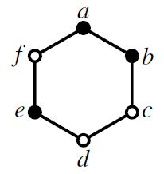
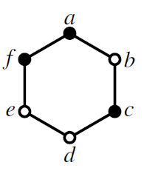



控制集

Slide 5



A
B
F
C
E
D

Slide 6
A quick scan

Slide 7
A
A
B
F
B
F
C
E
C
E
D
D
{A, D}, {B, E} : dominating sets
But, {A, D} cannot (safely) transfer to {B, E}.

Slide 8




Slide 9
A
required
A
B
F
free
B
F
C
E
C
E
D
D
{A, D}, {B, E} : (F,B,R)-dominating sets
But, {A, D} cannot (safely) transfer to {B, E}.

Slide 10





Slide 11
Applications

Slide 12

伺服器(server)配置

Slide 13
Previous Results

Slide 14
A
B
F
C
E
D

Slide 15




Slide 16



Slide 17





Slide 18




Slide 19
(F,B,R)-domination
(F,B,R)-2-stability

Slide 20


Slide 21





Slide 22

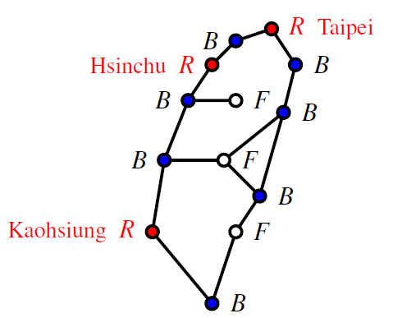

Slide 23
Our Results

Slide 24


first

Slide 25



second
third

Slide 26


second
third

Slide 27
Details

Slide 28



Slide 29

First main result

Slide 30



Second main result

Slide 31


Third main result

Slide 32
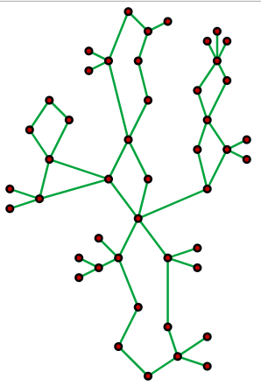
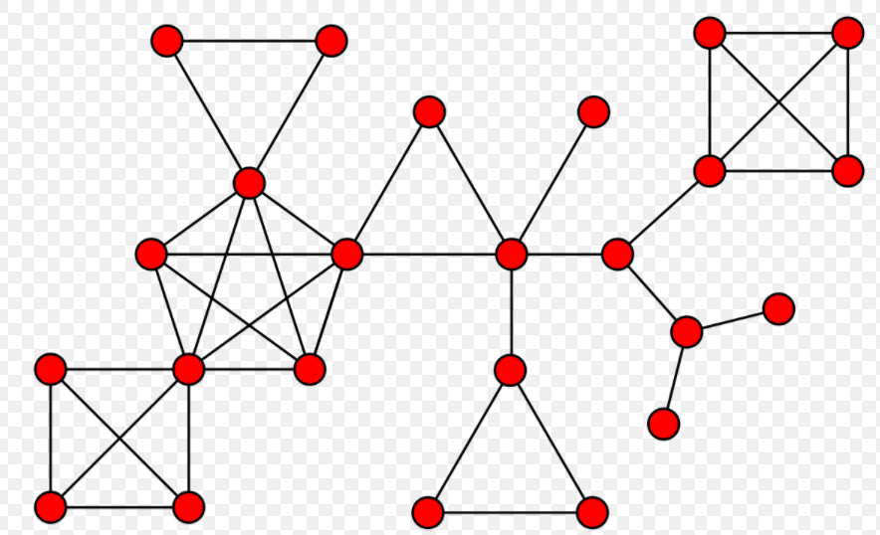
Definitions for third main result

Slide 33
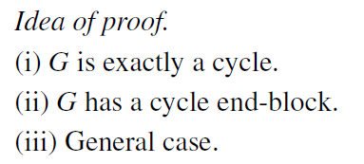

Slide 34



Concluding remarks

Slide 35


Slide 36
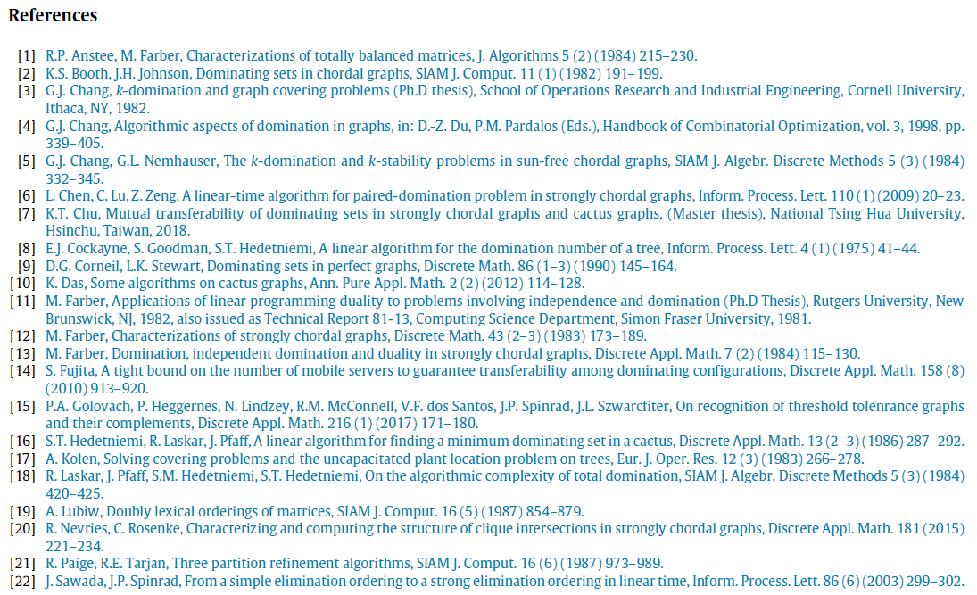

Slide 37
We want to thank Prof. G.J. Chang and S.C. Liaw..
Thank you for your attention.

